Slide 1

A Distributed IoT System for Non-Destructive Evaluation of Fitness and Integrity of Concrete Buildings and Structures. Architectural Design and Practical Demonstration.
MSc. Dissertation
Guillermo Navarro
Supervisor: Peter Barrie
Notes:
Notes

Slide 2
Agenda
Introduction
Background
Problem Statement & Scope
Methodology
Process
Technical definitions
Discussion
Proposed Design
Development and Testing
Conclusions & Recommendations

Slide 3
Introduction
Background

Slide 4
Background
In 2017, Mexico City was hit by a 7.1 magnitude earthquake
The aftermath caused the collapse of 44 buildings of which cumulative damage and structure fatigue played an important role of some buildings
NDE tests were used to detect and evacuate compromised buildings
The most common NDE method relied on visual inspections by civil engineers.
Emerging NDE tools and methods, including IoT and ML
IoT devices, such as (UAV), are emerging as important tools for new NDE techniques and systems
The Minnesota Department of Transportation deployed, and tested bridge inspections techniques aided by UAV
Ricardo Leal Da Silva and Diogo Schwerz de Lucena used a CNN model implemented in a system to detect fissures and cracks of structures
Notes:
-
- NDE: Non destructive evaluations or tests are methods used in the construction industry to inspect, assess, and evaluate materials in constructions without destroying or affecting serviceability of a structure. Visual inspections are one of the most common NDE techniques.
IoT:
the Minnesota Department argues that there are cost benefits, however, and more relevant for uav, the reach of these devices is greater than human auditors, as well as increased safety for the personel
In-Ho recommends safety guidelines to improve safety. The higher the resolution, the farther an UAV can monitor structures, and the safer the UAV will be from colliding. Area of focus can be affected, however recommends new acquisition techniques and machine learning models to overcome these problems (image condition problems such as contrast, illumination, resolutions)
Marouane had problems on latency, however for static or slow-moving imaging or monitoring this may not be a problem.
ML
Xiangzeng Liu requires low-resolution images with smooth or flat concrete surfaces to successfully identify cracks and fissures
Y. Fujita aims for better image quality rather than just plain resolution improvement
Ricardo Leal and Diogo Schwertz note that the dataset availability is limited and variety of dataset conditions (illumination, angles, vegetation, shades…) is not huge.

Slide 5
Introduction
Problem statement & scope

Slide 6
Problem Statement
NDE can increase risks of professionals and costs associated to evaluation and maintenance of infrastructures
IT tools and systems can aid professionals in the construction industry
Propose a distributed architectural system design for an NDE distributed system
Demonstrate and evaluate through a practical application

Slide 7
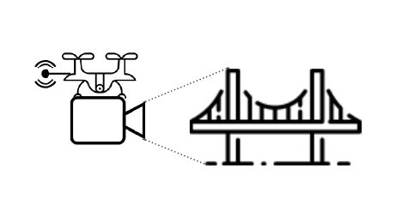


Scope
IoT Device system
Periodic transmission of data through an MQTT broker
Load and pre-process images
Command and message reception from MQTT
Machine Learning
Datasets: images of concrete surfaces
ETL: include an ETL process for image processing
Type: supervised binary classification model
End-result: classify images based on fissure or cracks
Cloud Platform
Provide infrastructure for end-system
Device Management
Data and dataset storage
ML Service
User Dashboard

Slide 8
Methodology

Slide 9
Methodology
Problem Statement
Scope
Literature Research
Evaluation of Literature
Technical Research
Technical Evaluation
Architectural Design
Implementation

Slide 10
Methodology
Technical component definitions

Slide 11
IoT Sandbox Requirements
Requirement | Definition
Storage | The simulation devices should be capable of storing images Substitutes the camera capabilities of physical devices
Image pre-processing | The simulation IoT device must be capable of image pre-processing
MQTT connection | Capable of connecting to cloud platforms via MQTT Receive and send messages through MQTT
Community | Active community or end-user manuals
Cost | Low cost

Slide 12
IoT Sandbox Platform
Node-red
noflojs
thingsboard
JavaScript
Flow-based programming simulation sandbox
Open source with a rich community
Flexible and scalable
3rd party plugin support
JavaScript
Flow-based programming simulation sandbox
Has a function to separate flows and activities of an application
Open source
3rd party plugin support
Java
IoT-specific platform for data collection, processing, and visualization
Device management
Enables an IoT ecosystem
End-to-end services and industrial support
3rd party plugin support

Slide 13
IoT Sandbox Platform
 | Node-RED [92] | NoFloJS [93] | ThingsBoard Community Edition [94]
Platform | Node.js | Node.js | Java
Sandbox Style | Flow based | Flow based | Event based
Base programming language | JavaScript (flow-based programming) | JavaScript (flow-based programming) | Java with microservices integration and Angular frontend.
Default communication protocols supported | MQTT HTTP | MQTT HTTP | MQTT HTTP CoAP SNMP LwM2M
Community Support | Yes | Yes | Yes
Plug-ins | Yes – palette | Yes - packages | Yes - widgets
Free tier / open edition | Yes | Yes | No (30-day free trial)
Cloud Platform Integration | Yes – through Node-RED plugins | No (reported as broken) | Yes

Slide 14
Cloud Platform Requirements
Requirement | Definition
Dashboard | End-user dashboard available to consume, track, review, and interact with the data and IoT devices Allow scalability to quickly incorporate new components Quick deployment for the developers Minimal system and hardware maintenance
Database and blob storage | NoSQL or relational database manager Blob Storage container
ETL Pipeline | Event-driven Quick and simple Capable of image processing Integrate with storage services
IoT service | Capable of providing IoT device management services Integrate a reliable and consistent messaging broker Integrate security protocols and services between the edge and the cloud
Machine Learning service | On-demand availability Fast training and deployment
Cost | Low cost

Slide 15
Cloud Platform Providers
Selected the three main popular cloud service platforms to implement the end-system with. These providers are AWS, Azure, and GCP:
All three platforms can host and deliver the end-system from a technical perspective
The three providers share similar services and SLA in the same regions
Promotion of owned services to compete
 | AWS | Azure | GCP
Market share | 32% | 20% | 9%
Free tier* | Yes
ETL Service | Yes | Yes
DBS and storage | Yes
ML Service | Yes
IoT Integration | Available

Slide 16
Costs breakdown
Each platform provider has a calculator to estimate the end-cost of the required services
The system scope requires the lowest-cost option available
Calculated costs are not final
 | AWS | Azure | GCP
PaaS service | $0.00 | $0.00 | $0.00
NoSQL DB Engine | $63.47 | $23.36 | $0.00
Blob Storage | $0.00 | $1.00 | $0.00
ETL | $0.00 | $0.00 | $0.00
IoT Services | $0.00 | $0.00 | $0.47
ML service | $146.12 | $64.02 | $2.34
Total estimated cost | $209.59 | $88.38 | $2.81

Slide 17
Discussion
Proposed Design

Slide 18
8-layer Architecture
A modification to Kumar R. et al 7-layer
Incorporates Al-Qaseemi’s et al. fog layer pattern
High level of detail for edge layer details
Outlines Big Data components, encapsulating ETL and ML
Incorporates an application layer and business process abstraction
Abstraction Layers:
Fog
Edge
Middleware
Connectivity
Cloud Infrastructure
Big Data
Data Ingestion
Data Analysis
Business Layer
Application
People & Process

Slide 19
8-layer Architecture
Fog layer
Edge Layer
Cloud layer
Cloud infrastructure layer
Middleware Layer
Big Data
layer
Data ingestion layer
Data Analysis layer
Business Layer
Application layer
People & Process layer
Connectivity Layer

Slide 20
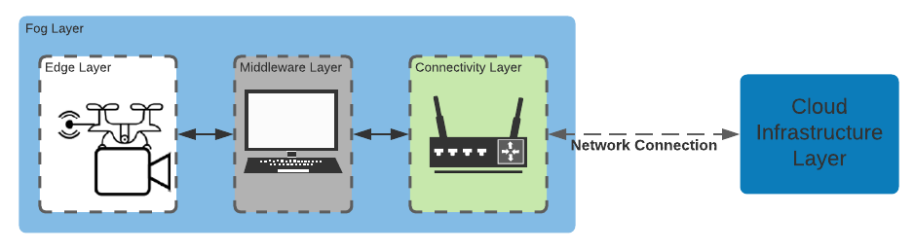
Fog Layer
Includes the Edge, Middleware, and Connectivity layers
Pre-process image captured from the camera
The middleware handles data in events of disconnections
A central gateway can act as a bridge between the edge and the cloud systems

Slide 21
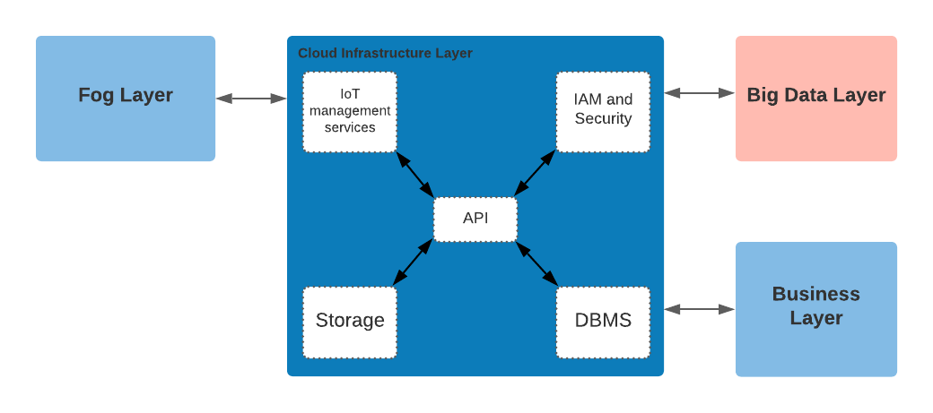
Cloud Infrastructure Layer
Cloud services management layer
Main technical platform where data exchange occurs
Abstracts cloud-specific components, such as storage, IoT management service, security components, and API services, among others.

Slide 22
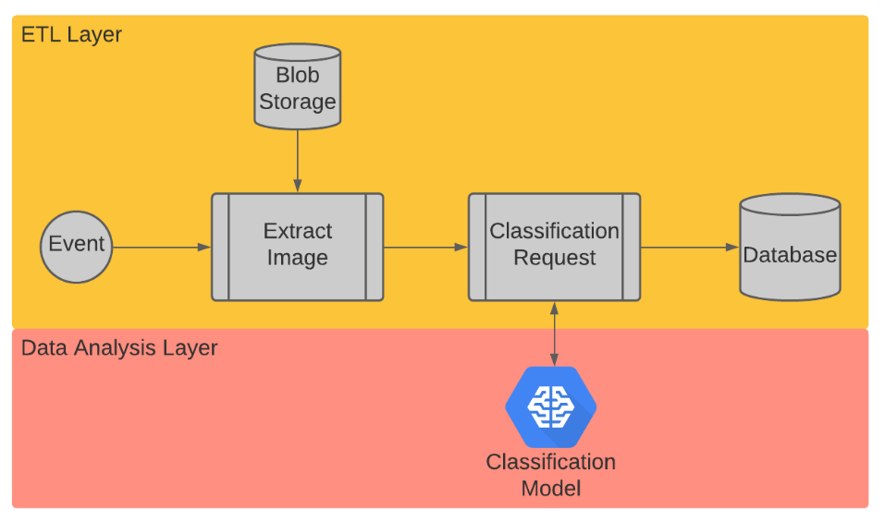
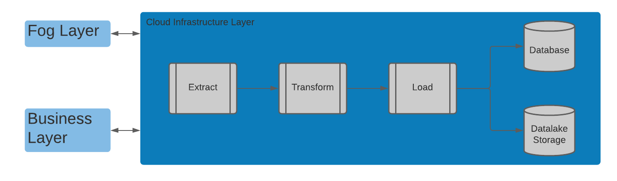
Big Data Layer
Data Ingestion or ETL Layer
Receives, processes, uncovers, and transforms data
An important component for ML services
Interacts with ML, storage, and database services
End-result is consumed and used by the business layer
Data Analysis Layer
Includes data analytics, model training, testing and validation, and model deployment processes
Consumes data processed by the ETL layer

Slide 23
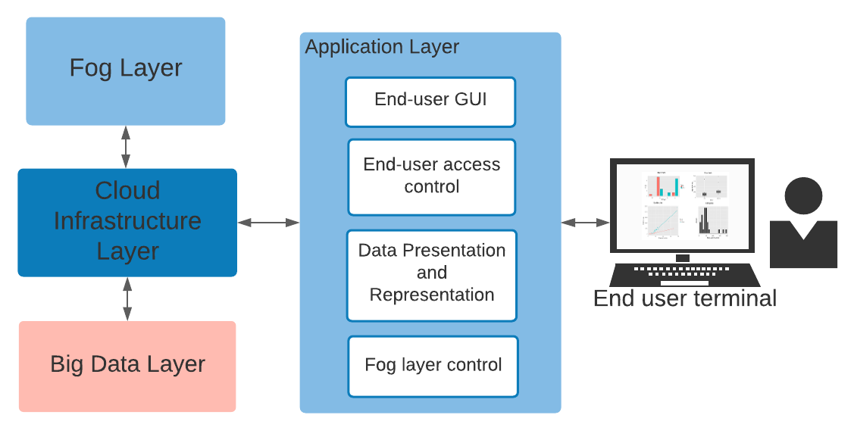
Business Layer
Application layer
It represents any application that uses data from lower layers, and presents it via a GUI to end-users
In the context of the prototype, the dashboard application that has access to the data
Peoples and process layer
This abstraction represents the end-users, business and functional processes, and other stakeholders and processes relevant for decision-making.
In the context of the NDE system, end-users will verify logs and data of the system to take decisions:
Verify whether classification is accurate. If so, actions must be taken based on events triggered by detection of fissures.
If classification is incorrect, trigger reclassification or correction step-actions to improve NDE process.

Slide 24
Discussion
Development and testing

Slide 25
Simulation Sandbox
Through Node-RED, an event-flow was developed for the prototype
The requirements from the scope were fully developed:
Image extraction and pre-processing
Local repository
Image re-sizing
MQTT connection
Send and receive messages from the cloud
Push images from the local system to the cloud
Remote control

Slide 26
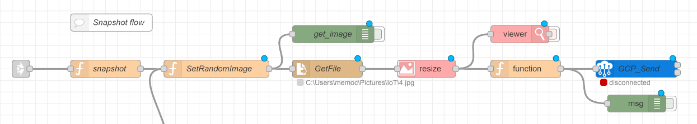
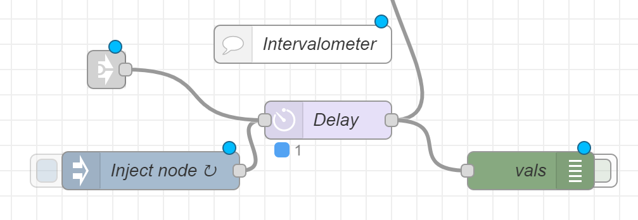
Simulation Sandbox – Image process flow

Slide 27
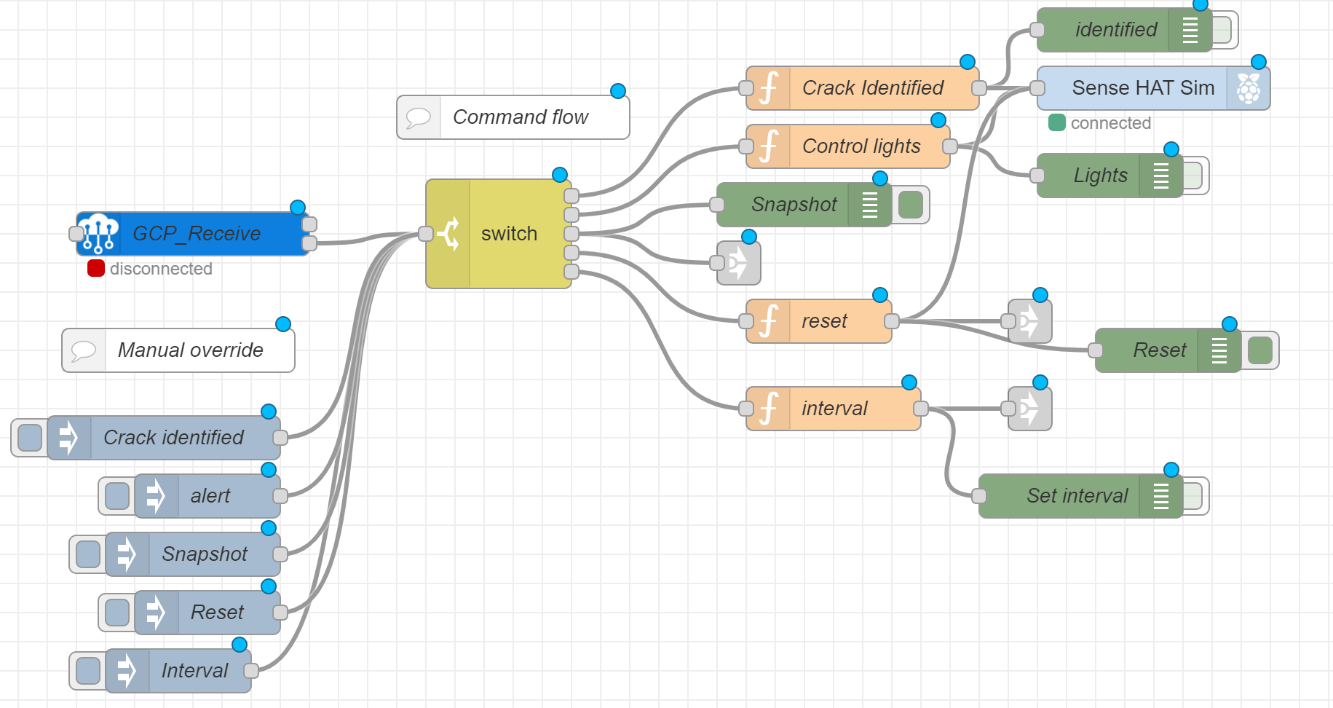
Simulation Sandbox – Commands flow

Slide 28
Fissure and Cracks Binary Classification Model
Binary classification
Crack: fissures present
No crack: no fissures
Vertex AutoML
Integrated with cloud storage services
API available (online and batch prediction)
Fast, simple development process
80% training, 10% testing, 10% validation

Slide 29
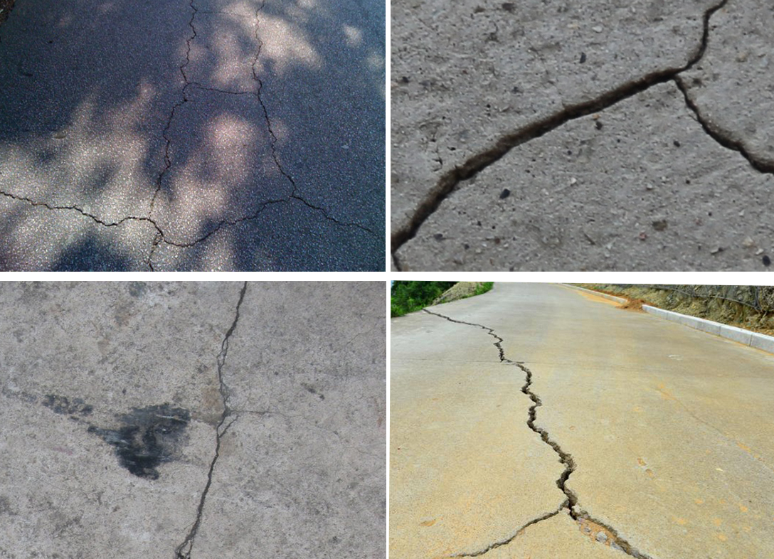
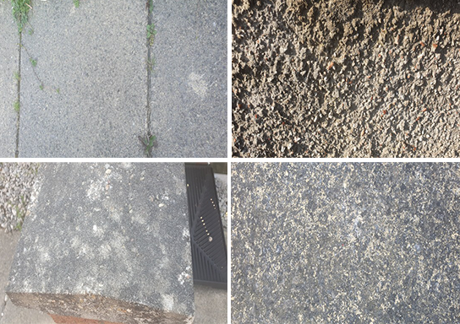
Dataset samples
537 Crack images (69.46%)
236 No crack images (30.53%)

Slide 30
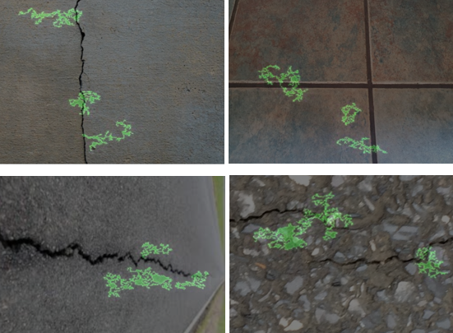
Model Results
Vertex AutoML data is limited
Accuracy: how accurate the classification is
Recall: wrong classifications
Vertex accuracy estimation:
Accuracy: 98.7%
Recall: 98.7%, with one false positive event
XRAI: results visualization tool
Accuracy may not be reliable or accurate
The model seems to be overfitted

Slide 31
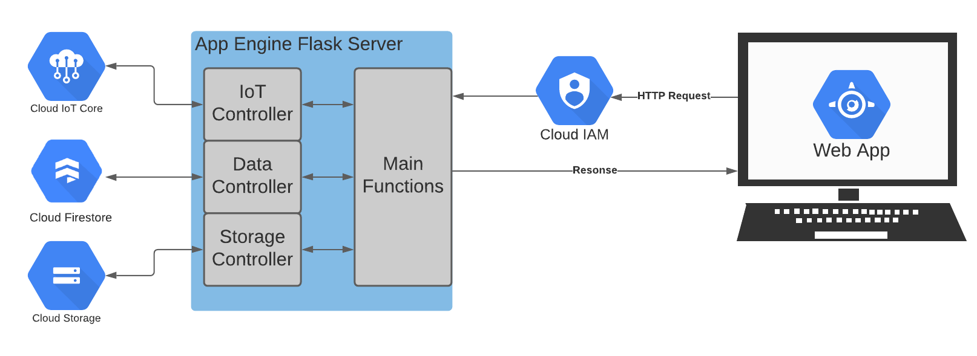
User Dashboard
Developed using App Engine
Web UI which is available to users registered in the project
The dashboard functions includes:
Summarization view
IoT registries and devices visualization
Data, logs, and images dashboard

Slide 32
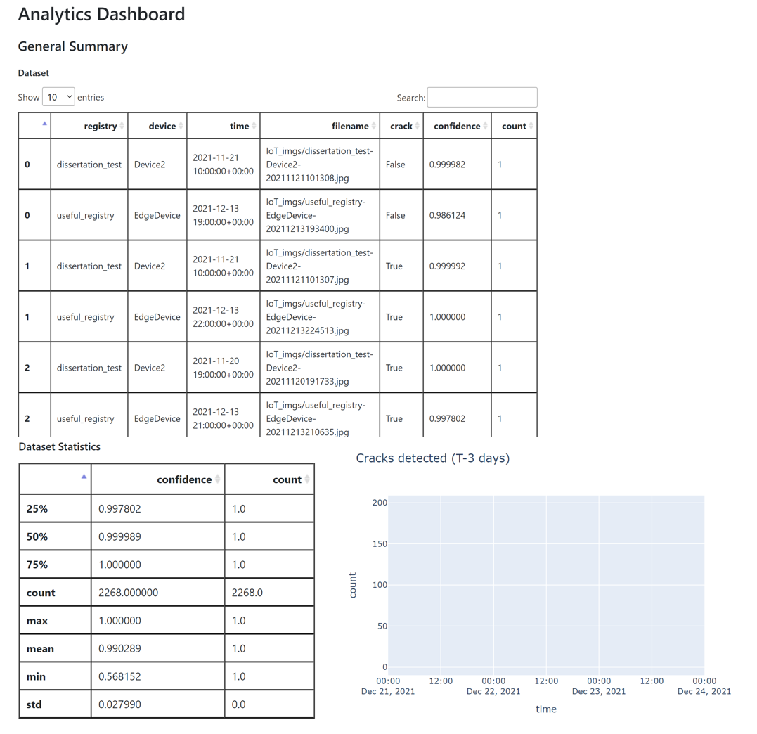
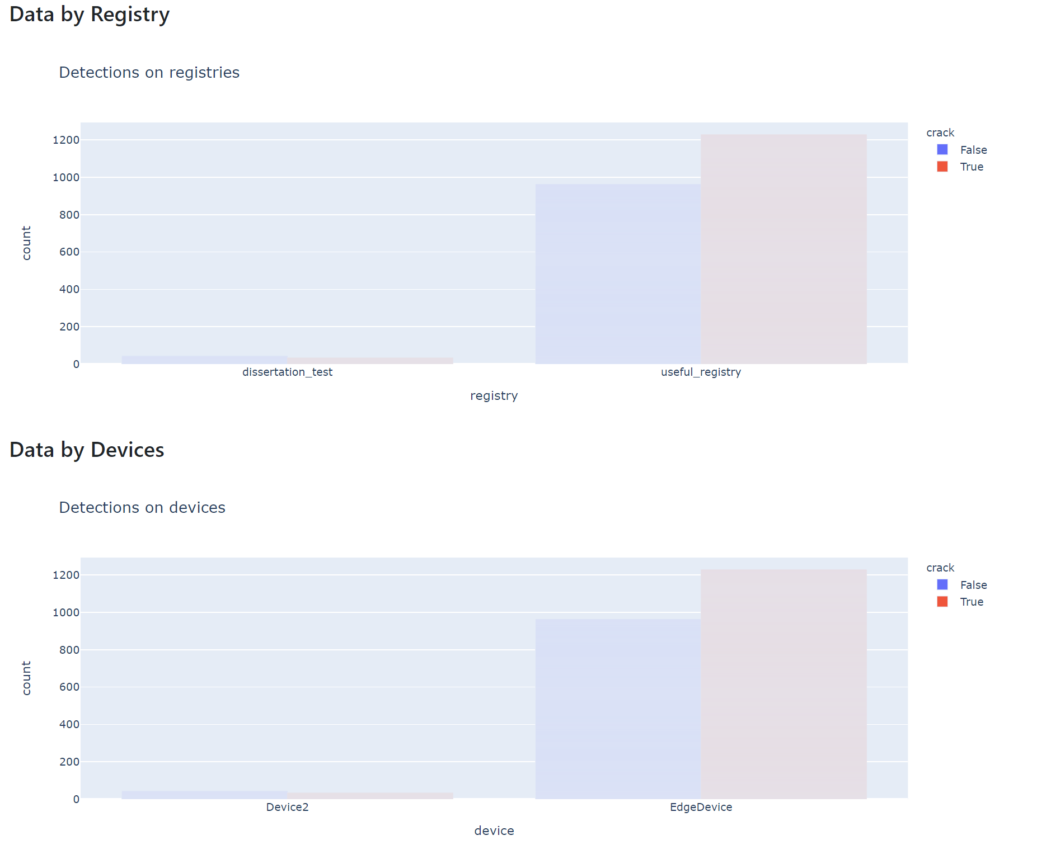
Application Dashboard

Slide 33
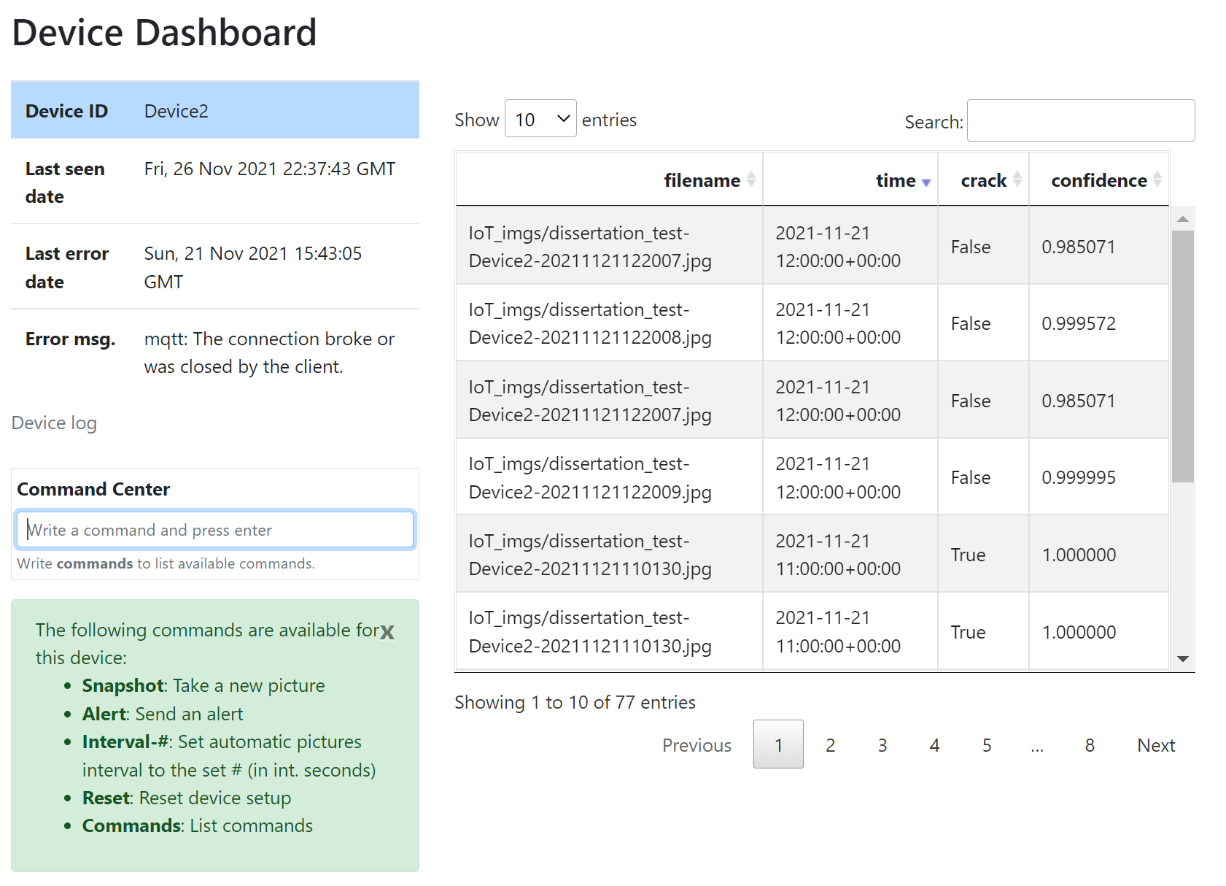
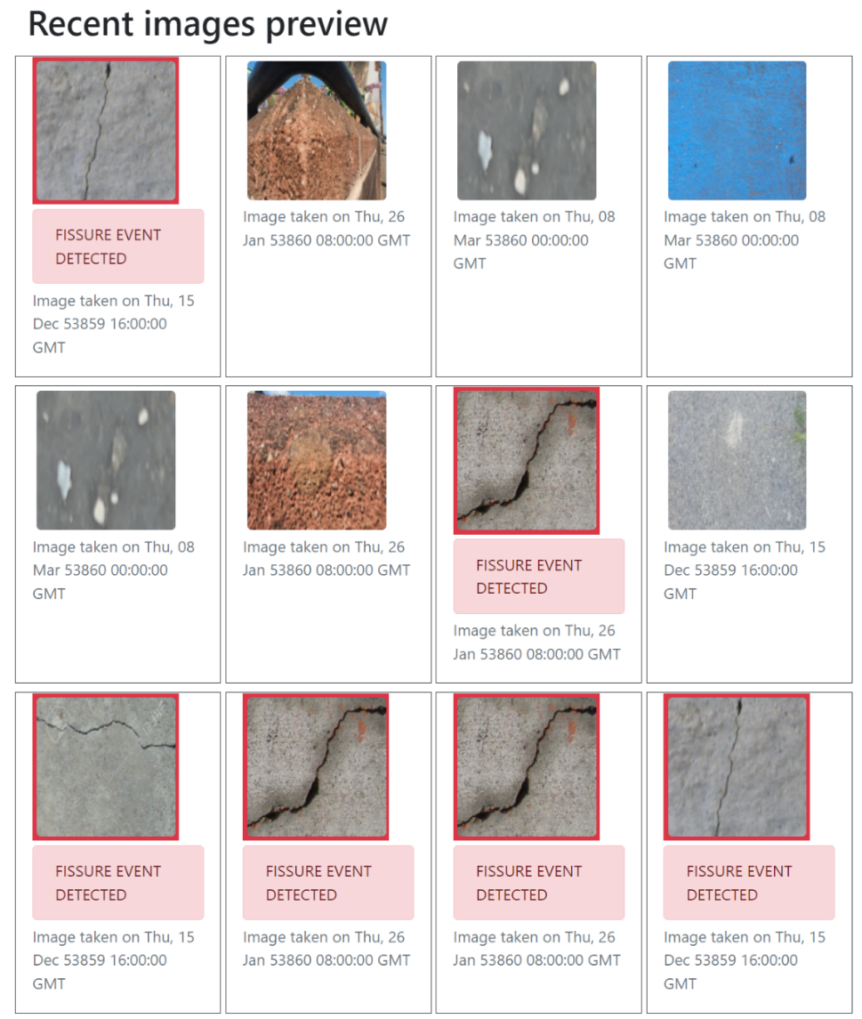
Application Dashboard

Slide 34
Conclusions & Recommendations
Conclusions

Slide 35
Conclusions
Architecture design and implementation
The architecture design goal was to integrate an IoT component and a big data and analytics
The 8-layer abstraction level allows to explain and highlight the four of the main components of the scope
Retains advantages which the 5-layer designs offer
The end-prototype demonstrated a successful implementation based on the design
IoT simulation was fast and simple to implement
The ML was deployed and used for the end-system
The cloud platform hosted and integrated most of the components

Slide 36
Conclusions
Limitations and missing requirements
Vertex AutoML creates a black box for system integrators
Physical device testing
Dashboard reclassification function
NDE system
A similar system has potential to be included for assessment tools and processes
There are important areas of improvement, including model performance
Low costs

Slide 37
Conclusions & Recommendations
Recommendations & future works

Slide 38
Recommendations and Future works
Incorporation and expansion of richer, more diverse datasets
New toolsets and sensors in IoT devices, such as percussion-based or infrared cameras, can uncover interesting data
Further investigation in ML and AI for NDE systems
Services like Vertex AutoML should be avoided for niche systems or systems where fine-tuning is important

Slide 39
Thank you
Questions

